Slide 1
Kyrgyzstan in the 1950-80s
Cholpon Chotaeva
Anthropology, AUCA

Slide 2
Repressions
Repression was the prosecution of people considered as anti-revolutionaries and enemies of the people
Repressions were motivated by the desire of Stalin to remove dissident and opposition from the Bolshevik party and to consolidate his authority

Slide 3
Repressions
Before 1934: the expulsion from the party and position
After 1934: the execution
Kirov's murder in 1934 was used as a pretext to repressions, in which about a million people perished

Slide 4
Repressions
Opposition leaders: Trotsky, Bukharin
Social groups: kulaks (1931)
Ethnic groups: Kurds of Armenia and Azerbaijan, Koreans of the Far East, Volga Germans, Ingush, Karachais, Chechen, Balkars, Kalmyks, Crimean Tatars, Mesketian Turks of Northern Caucasia (1930s)

Slide 5
Repressions in Kyrgyzstan
Repressions of nationalist leaders in 1928-1938 : Sydykov, Abdyrakhmanov, Aidarbekov, Aitmatov (shot in 1938 in Chon Tash and other places)
More than 40,000 people were repressed in Kyrgyzstan with the population of 1.4 million people

Slide 6
Great Patriotic War
(1941-1945)
24 August 1939 - Treaty of Non-Aggression (the Molotov–Ribbentrop Pact)
Secret protocol dividing Northern and Eastern Europe into German and Soviet spheres of influence
22 June 1941 - Germany invaded the USSR (Operation Barbarossa)

Slide 7
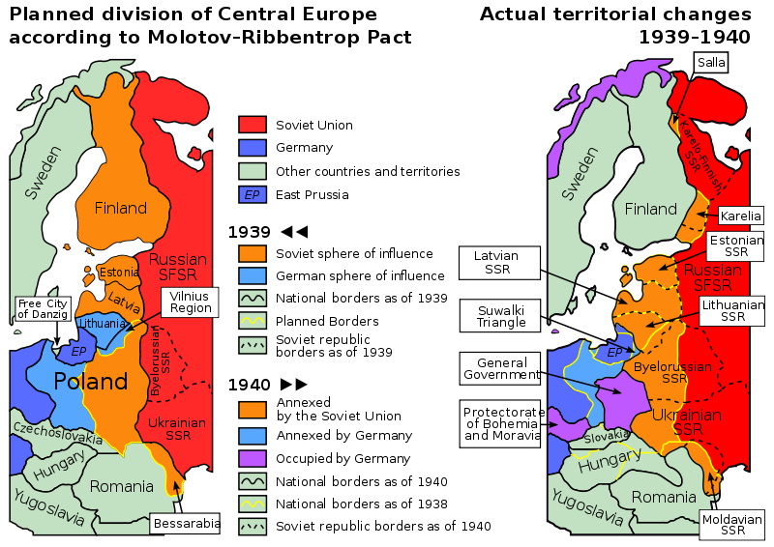
Secret Protokol of 1939

Slide 8
Kyrgyzstan: on the war front
380,000 Kyrgyzstanis fought on the war fronts
More than 90,000 were killed
More than 150,000 were awarded with orders and medals
Among them 73 were awarded with the Hero of the Soviet Union
Begeldinov was awarded the Hero of the SU twice

Slide 9
Kyrgyzstan: on the war front
385th rifle division, 40th and 153rd rifle divisions and 2nd national cavalry division
385th Panfilov rifle division: 34 solders were awarded the Heroes of the Soviet Union: Shopokov, Ananyev, Shemyakin, Konkin, Moskalenko, Petrenko

Slide 10
Kyrgyzstan: on the war front
Heroic deeds:
Dmitriev defended the Brest fortress (the Hero of the SU)
Cholponbai Tuleberdiev shut the pillbox with his breast (the Hero of the SU)
Daiyr Asanov during 4 hours of battle destroyed 8 tanks, 6 armoured vehicles and 40 fascists (the Hero of the SU)
Akun Sadyrbaev could catch and throw back 16 grenades (the Hero of the SU)
Ismailbek Taranchiev directed his plane to the enemy’s tanks at and destroyed 6 tanks and several cars (1991 - the Hero of the SU)

Slide 11
Kyrgyzstan: on the home front
By December 1942 more than 138,000 people were evacuated
More than 30 large industrial enterprises were evacuated
Weaponry and bullets
189 million rubles were sent
195 wagons of food were sent

Slide 12
Khrushchev era
(1953-1964)
Period of Khrushchev Thaw - a shift in political, cultural and economic life in the Soviet Union
De-Stalinization - denouncing Stalin's dictatorial rule and cult of personality (20th KPSS Congress)
Virgin Land Campaign in the mid 1950s (giving land for farming in Kazakhstan)
1962 Cuban Missile Crisis (Caribbean Crisis) - a confrontation between the US, USSR and Cuba

Slide 13
Brezhnev era
(1964-1982)
Period of Stagnation - lack of radical changes in political, cultural and economic life in the Soviet Union

Slide 14
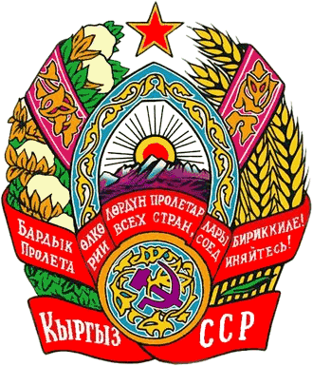
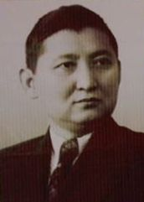
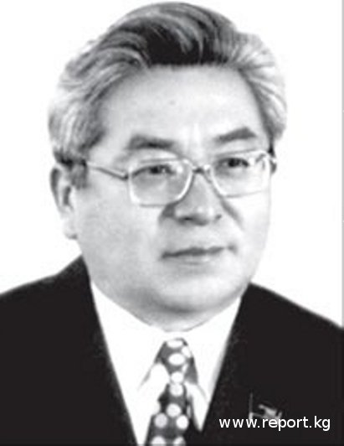
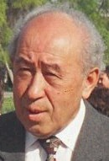
Kyrgyz leaders
(1950-1991)
1950-1961 – Ishak Razzakov
1961-1985 – Turdakun Usubaliev
1985-1991 – Absamat Masaliev

Slide 15
Ishak Razzakov
(1945-1961)
Economy: 20 new objects were built
Education: KGU, Osh, Przhevalk, Polytechnic, Physical Labor institutes
Science: Academy of Sciences (1954), conferences of Manas epic, 1916 rebellion
Publishing: Mektep and Ilim
Art: Opera and Ballet House, literature
Charged with nationalism and dismissed

Slide 16
Turdakun Usubaliev
(1961-1985)
Economy: 150 enterprises (Toktogul Hydroelectric Power Station, Maili Sai lamp plant, Kant cement plant)
Education: Kyrgyz was stopped being taught at schools
Culture: Russification, internationalization
Deputy of the Legendary Parliament
Hero of the Kyrgyz Republic
Charged with patronage, corruption and mismanagement

Slide 17

Perestroika
1985-1990 – Gorbachev
is the General Secretary of
the Communist Party
1990-1991 – President of
the Soviet Union
Initiator of Perestroika policy

Slide 18
Policy of Perestroika
Perestroika - the sum of political and economic reforms in 1985-1991 (27th Congress of Communist Party)
Aim: to improve the economy within the socialist system (humanist socialism)
Results: the escalation of the crisis, the elimination of the Communist Party domination and the dissolution of the USSR

Slide 19
Foreign policy
1987 - Immediate Nuclear Forces abolition treaty signed with USA
1989- withdrawal of Soviet troops from Afghanistan
End of the Cold War
Collapse of Socialist system

Slide 20
Political development in Kyrgyzstan
Cadre policy of Gorbachev
1985-1991 – Absamat Masaliev
was appointed the first secretary
1990-1991 – a Member of Politburo of the Central Committee of the USSR’s Communist Party
2000- A Deputy of Jogorku Kenesh

Slide 21
Political development in Kyrgyzstan
Demos, Zamandash (Kyrgyz National University),
Koz Karash (the Institute of Economy)
Ashar - the organization of unauthorized housing constructors who seized land plots around Bishkek city
Osh Aimagy – the organization of unauthorized housing constructors who seized land plots around of Osh city
Adolat – the organization of Uzbek youth of Osh city
Asaba – national-democratic party
Democratic Movement of Kyrgyzstan (Asaba, Erkin Kyrgyzstan, etc)

Slide 22
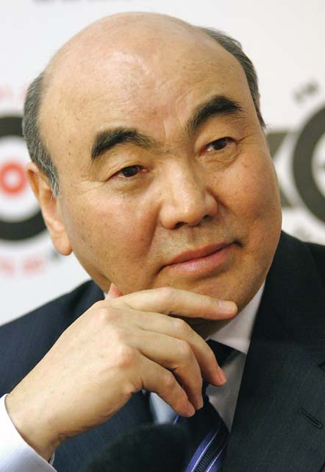
Political development in Kyrgyzstan
1990 - elections to the Supreme Soviet of the Kyrgyz SSR and the creation
of Legendary Parliament
1990 - presidency
Akaev was elected
the first president

Slide 23
Political development in Kyrgyzstan
December 15, 1990 - Declaration on the State Sovereignty of the Republic of Kyrgyzstan
March 1991- 88.7% voted to preserve and remain in the USSR
December 1991 – 11 republics signed the creation of CIS and the dissolution of the USSR

Slide 24
Economy
Transition from totalitarian and planned economy to market economy
Self-financing and self-management (1987 Law on State Enterprise)
Cooperatives and farms (1988 Law on Cooperatives)
Denationalization and privatization (1991)

Slide 25
Language issue in Kyrgyzstan
1989 Law “On the state language of the Kirgiz SSR” and the Resolution of the Supreme Council
Aims:
the elimination of a great disparity between the use of Russian and Kyrgyz
the promotion of the social status of Kyrgyz
decentralization of power from Moscow
nation-state building

Slide 26
1990 Osh conflict
June 1990 - the clashes between Kyrgyzs and Uzbeks in Osh province led by “Osh Aimagy” and “Adolat”
The causes:
economic situation of both groups (land issue, housing problem)
social problems (unemployment, poverty, migration)
political causes (political power in the hands of Kyrgyzs)
demographic causes (Uzbeks were urban, Kyrgyzs rural)
cultural causes (language policy)
Results: 300 people killed (by official estimations)
1000 people (by unofficial sources)

Slide 27
Other social problems
Alcoholism (40 million alcoholics)
Drug abuse
Criminality: 1980 – 11700 crimes
1985 – 14400 crimes
1989 – 25500 crimes
1980 - 40% of crimes were not opened 1989 - 291 people murdered

Slide 28
Conclusion
Although many reforms were introduced, they could not be fully implemented within the frames of the existing socialist system
The result was the dissolution of the Soviet Union and creation of fifteen independent states

Slide 29
Readings
Gorbachev Michael speeches

